Slide 1
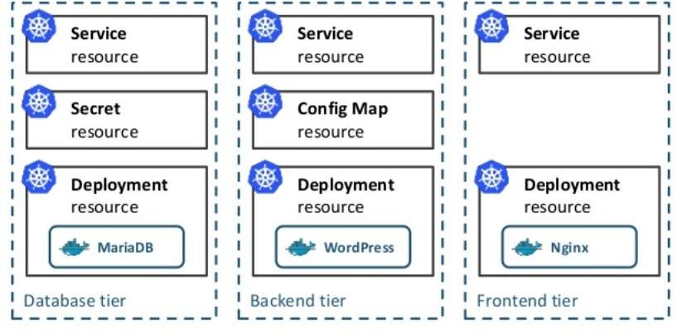
1 MicroService == 1 POD + 1 Deployment + 1 ReplicationSet + 1 Service (+ 1 Ingress)
Lifecycle Management of Applications are very hard
Kubernetes
The Pain Point

Slide 2
What is HELM
Package manager
Like yum, apt but for Kubernetes
Search and reuse or start from scratch
Lifecycle Management
Benefits
Repeatability
Reliability
Multiple environment
Ease collaboration
Manage Complexity
Create
Install
Upgrade/Rollback
Delete
Status
Versioning

Slide 3




Helm Client
Command-line client
Interacts with Tiller Server
Local chart development
Tiller Server
In-cluster
Listens to the Helm client
Interacts with Kubernetes API Server
Manages the lifecycle
Helm
Components
gRPC
REST
Kubernetes API Server
Helm Client
Tiller Server
Kubernetes Cluster

Slide 4
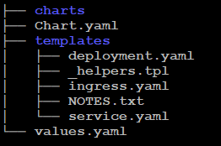
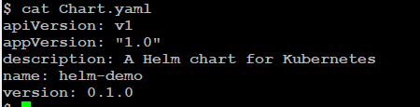
Application Deployment Blueprint
Collection of K8S resource definition files inside a directory
Can deploy simple and complex applications
Helm Charts

Slide 5
Install HELM
curl <address> | sudo sh
https://raw.githubusercontent.com/kubernetes/helm/master/scripts/get
https://get.helm.sh
https://github.com/kubernetes/helm/releases

Slide 6
Minikube
Available on all major platforms
https://github.com/kubernetes/minikube
minikube start
minikube status
minikube dashboard

